Slide 1
Gain sag and E/p ratio: comparison with laser results Sam Grant (ω_{a} Europa) 17th May 2019

Slide 2
Preamble
I am using the tau and amplitude values contained in the fcl file:
“gm2Dev_v9_20_00/srcs/gm2calo/fcl/inFillGainParams_withlognstdp.fcl”
If anyone wants my values, I have them in both csv and ROOT format
Question: why no uncertainties in the fcl file?
*Detail on cuts ect in backup

Slide 3
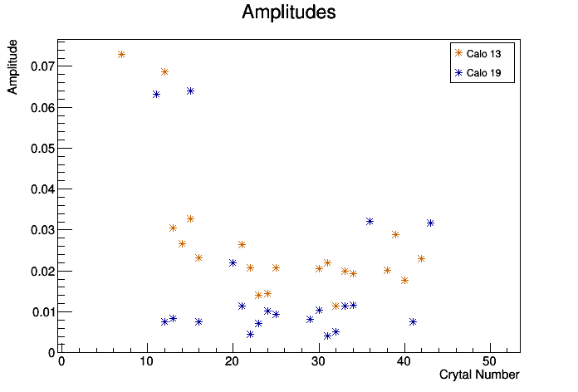
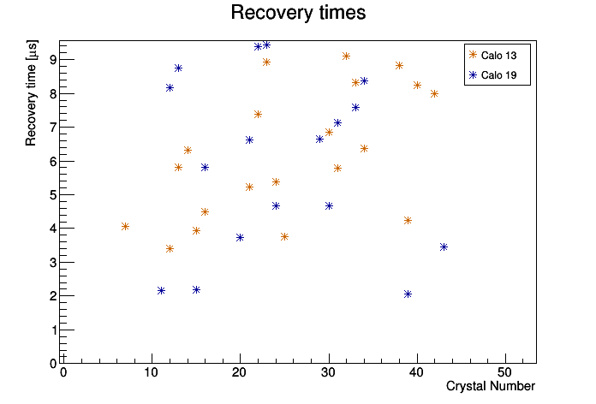
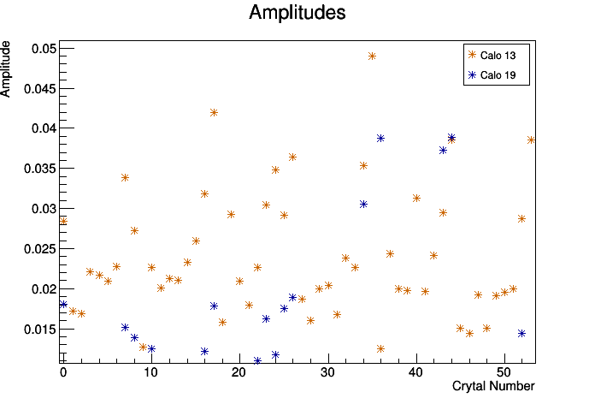
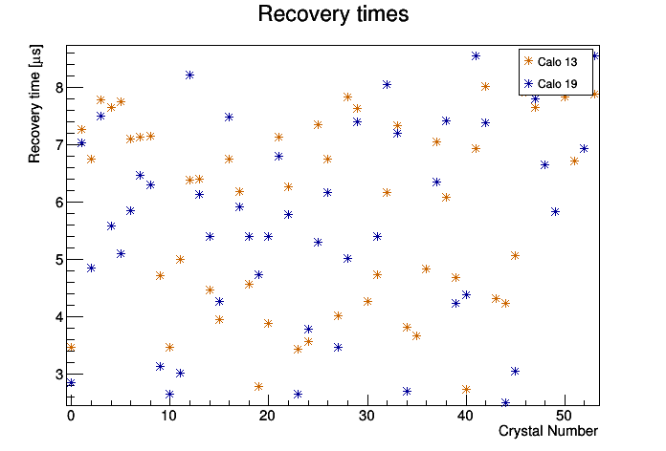
Scatter plots: E/p results and laser results
E/p ratio:
Laser:

Slide 4
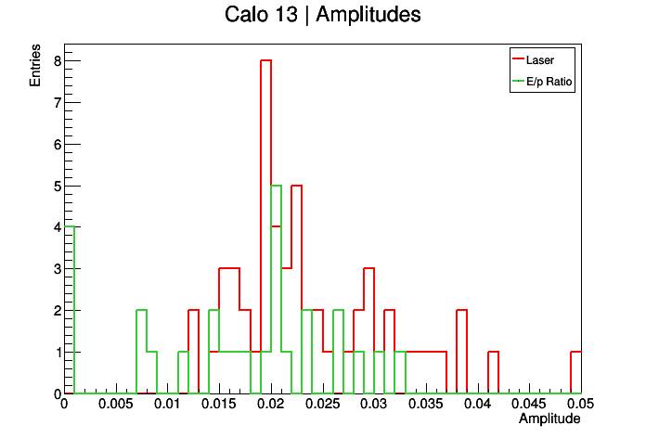
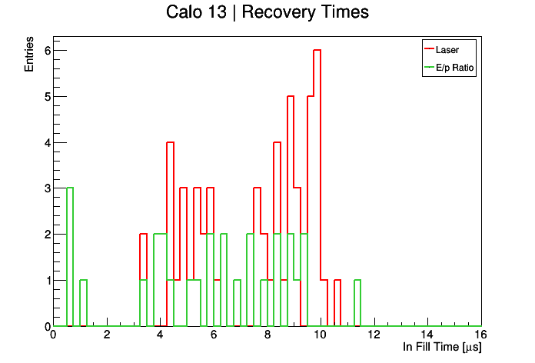
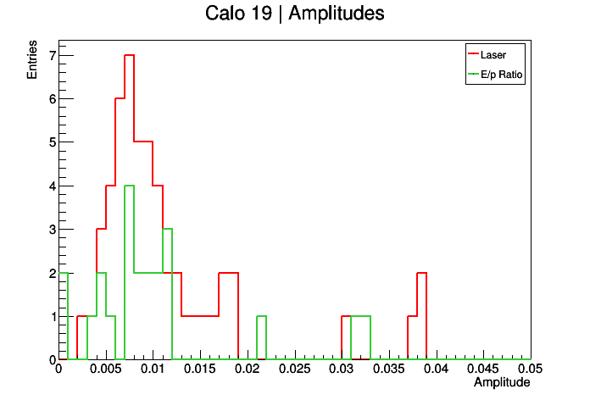
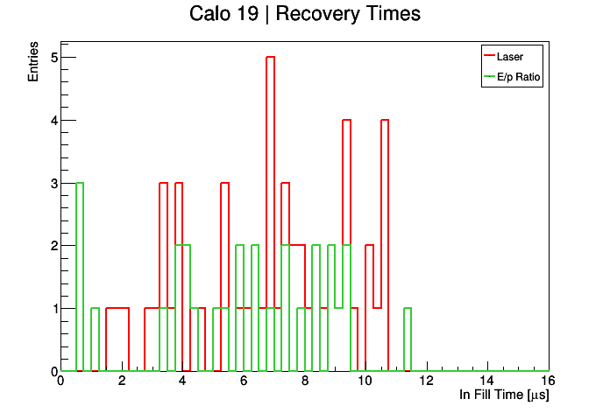
Histograms: E/p results and laser results

Slide 5
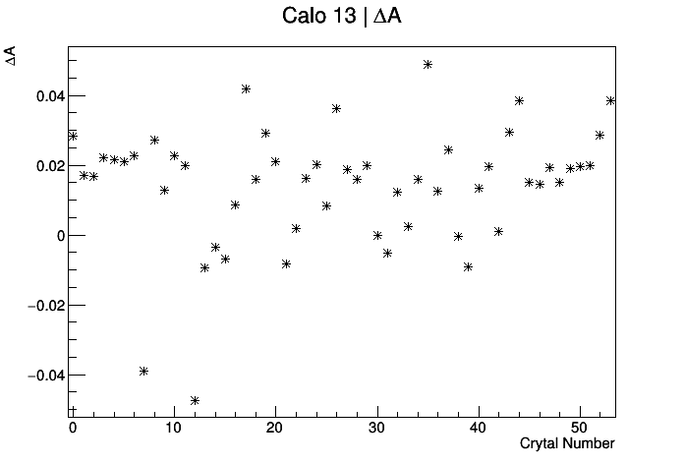
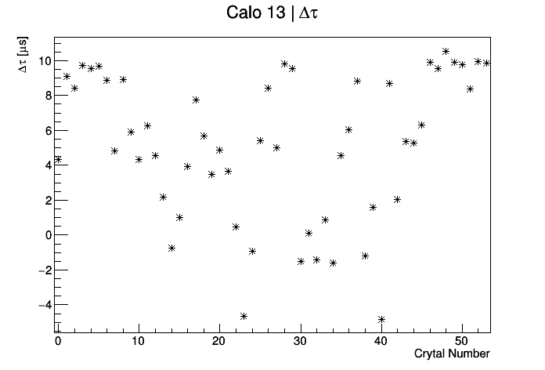
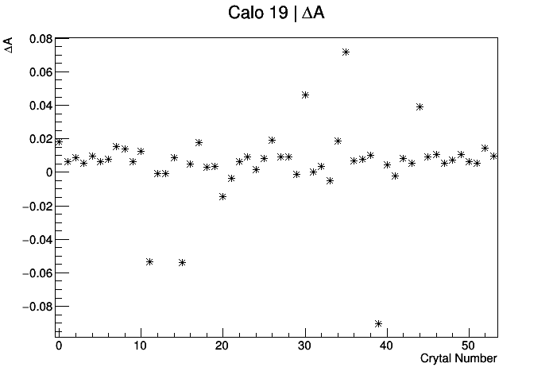
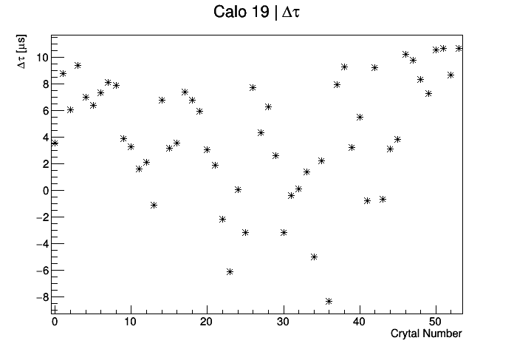
Differences between laser and E/p results
Mean difference = 0.0142067
Mean difference = 4.18167 us
Mean difference = 0.00529655
Mean difference = 5.11914 us

Slide 6
BACKUP

Slide 7
E/p ratio
Tracker-calo matched tracks provide a different way to measure gain.
The trackers measure the track curvature to get momentum, p, which is not affected by the flash
The calorimeter give the cluster energy, E, of the same track
Particles are relativistic, so E=p
E/p is therefore equivalent to gain

Slide 8
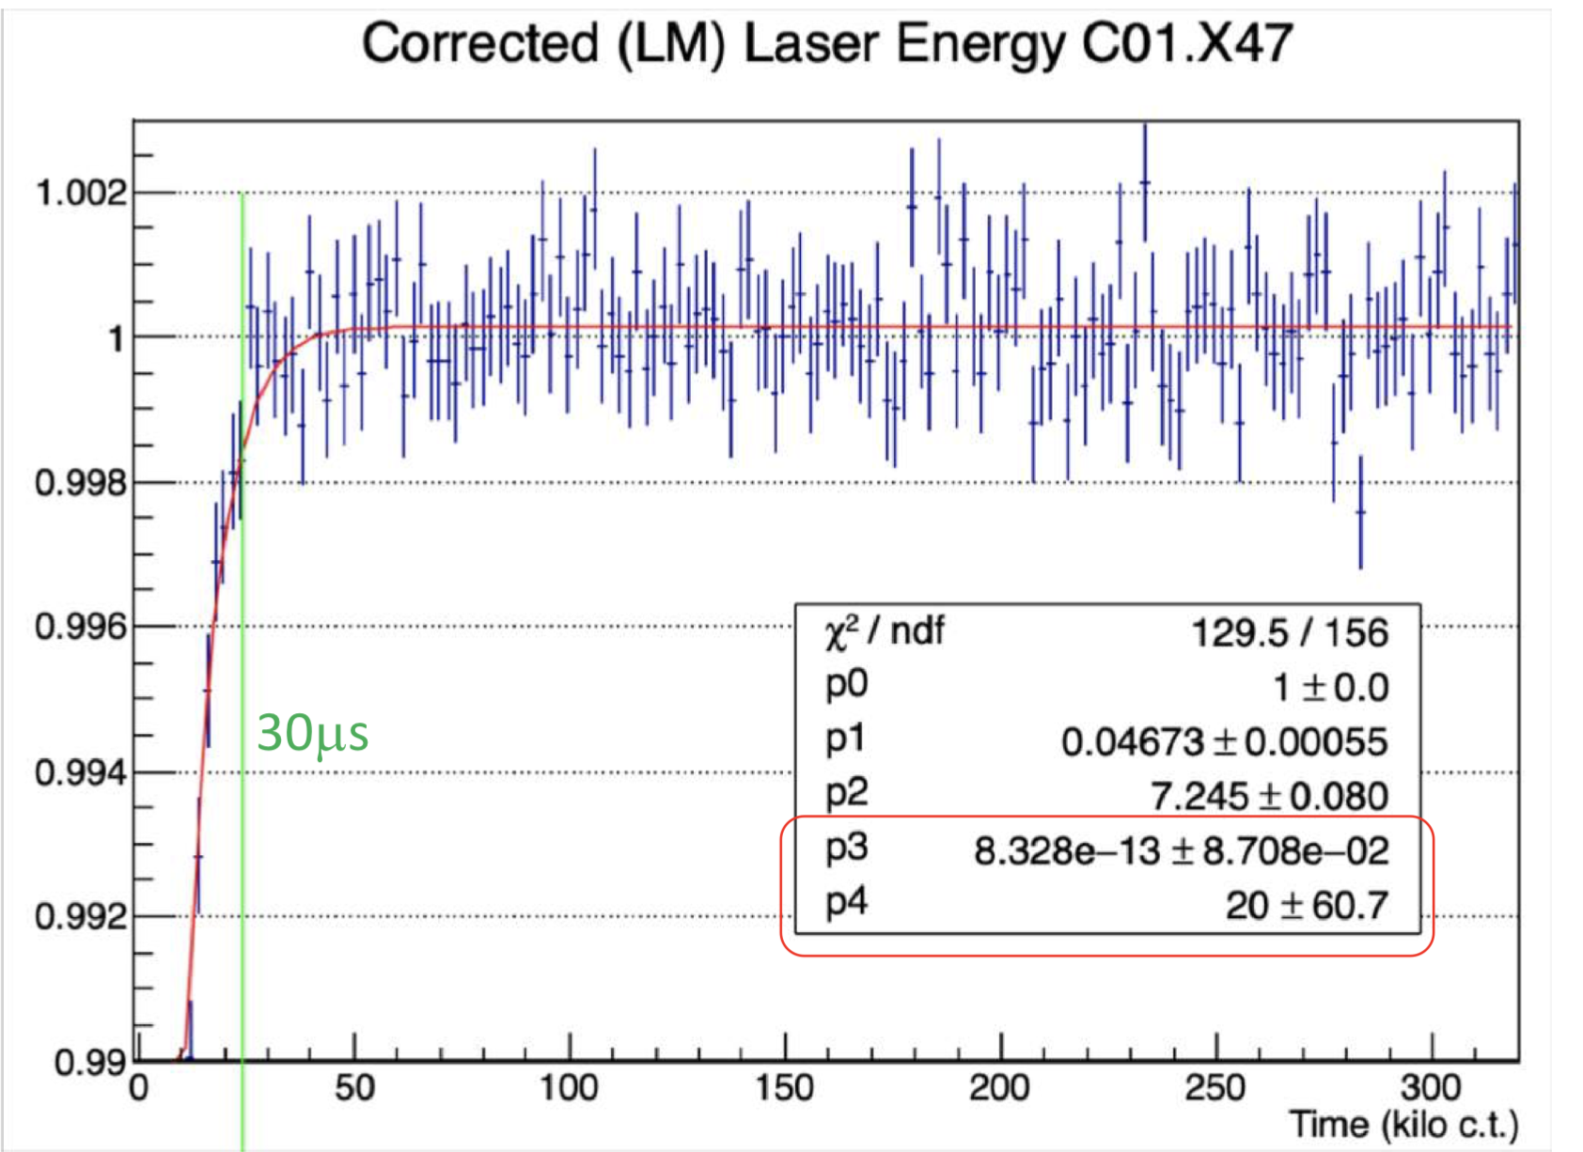
Gain sag
Just after injection there is a slight drop and subsequent recovery of gain, which must then be corrected!
We can double check the results from the laser, and hence the gain corrections, by using tracker-calo matched tracks.
Credit: ω_{a} Europa
https://gm2-docdb.fnal.gov/cgi-bin/private/ShowDocument?docid=17009

Slide 9
Method
Make 2D plots of E/p vs t
Fit y-projections of each x-bin with gaussians, and plot the gaussian mean and it’s error (a better alternative to a profile)
Separate tracks according to breaker board
Require 1 crystal hit per track
Fit resulting distribution to extract the recovery time and gain sag amplitude with function:
Repeat process on a crystal by crystal basis
Compare with laser results

Slide 10
Details!
Using Europa Ntuples, available in:
gm2/data/g2be/Production/Trees/v9_17_01/60hr/
Tracker group’s quality flag: “Track quality = true”. See James Mott (2019):
https://gm2-docdb.fnal.gov/cgi-bin/private/ShowDocument?docid=16444
Cluster track time difference between -8 and +3 ns for station 12, and between -9 and +1 ns for station 18
Radial difference, dR < 30 mm
Positron selection:
-0.3 < Log(E/p) < 0.2;
Region of highest flux:
1.2< E [GeV] < 2.4

Slide 11
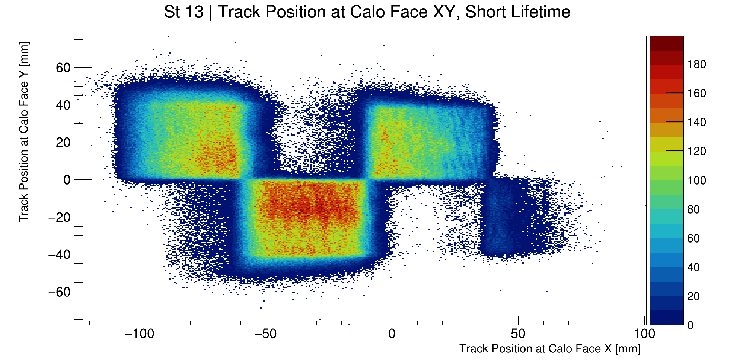
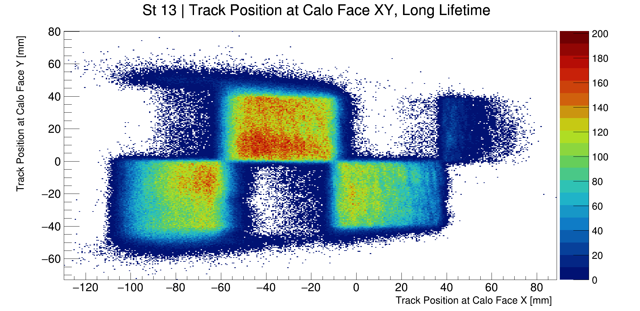
Breaker Boards
Different breaker boards mean different recovery times, when combining crystals it is important to only combine those connected to the same board
Short Life Times (by crystal), xtalShort[22]= {0, 9, 10, 11, 14, 15, 18, 19, 20, 23, 24, 27, 30, 31, 34, 35, 36, 39, 40, 43, 44, 45}
See Jason Hempstead (2018):
https://gm2-docdb.fnal.gov/cgi-bin/private/ShowDocument?docid=12263&version=1

Slide 12
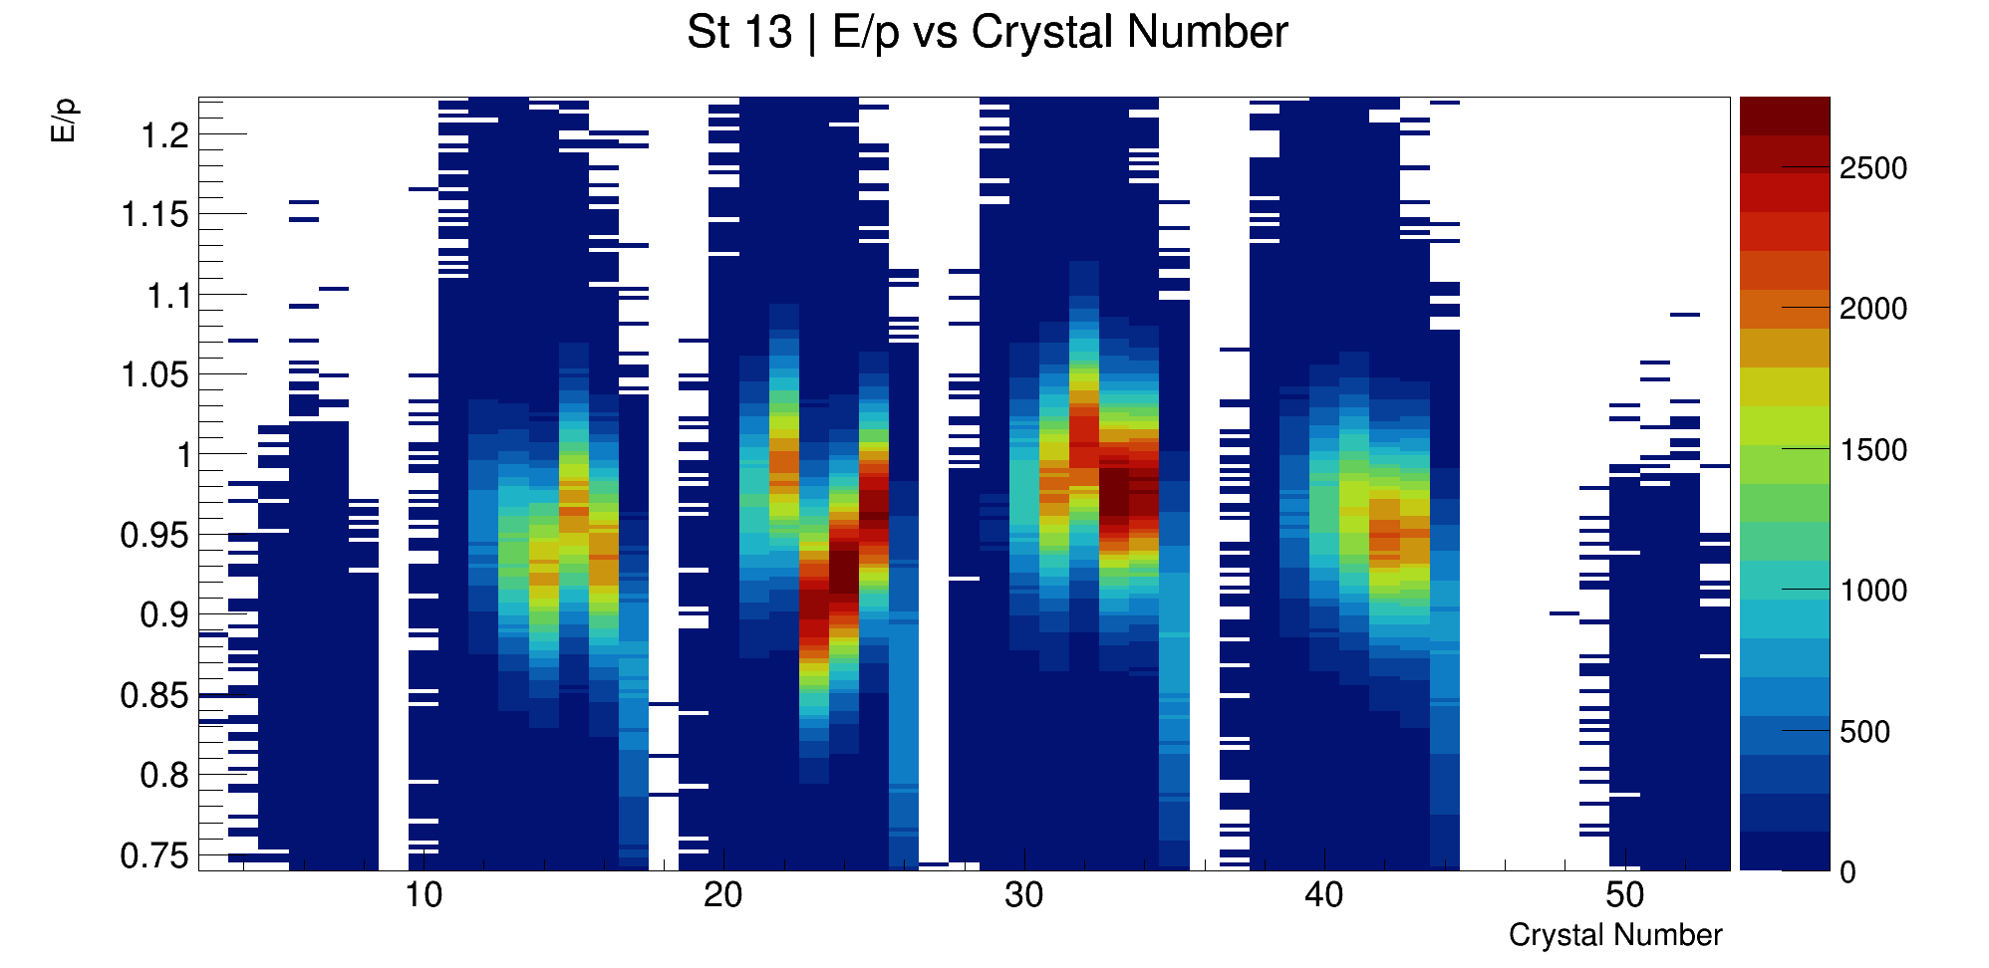
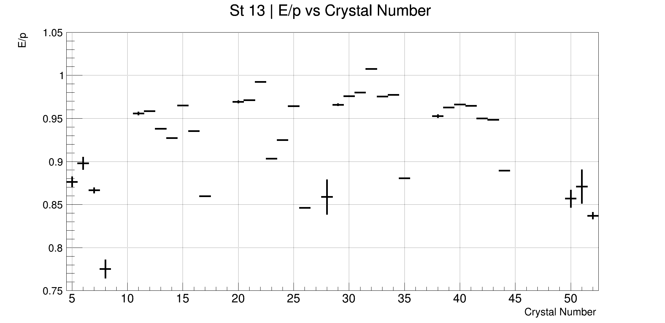
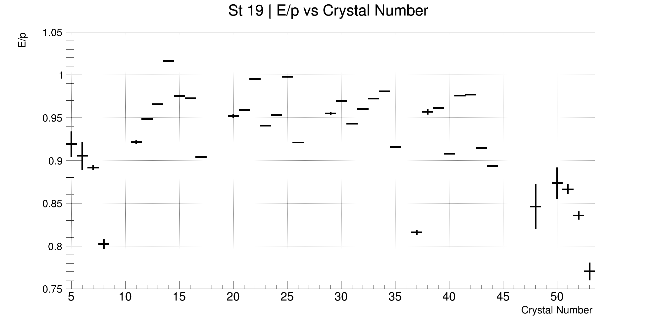
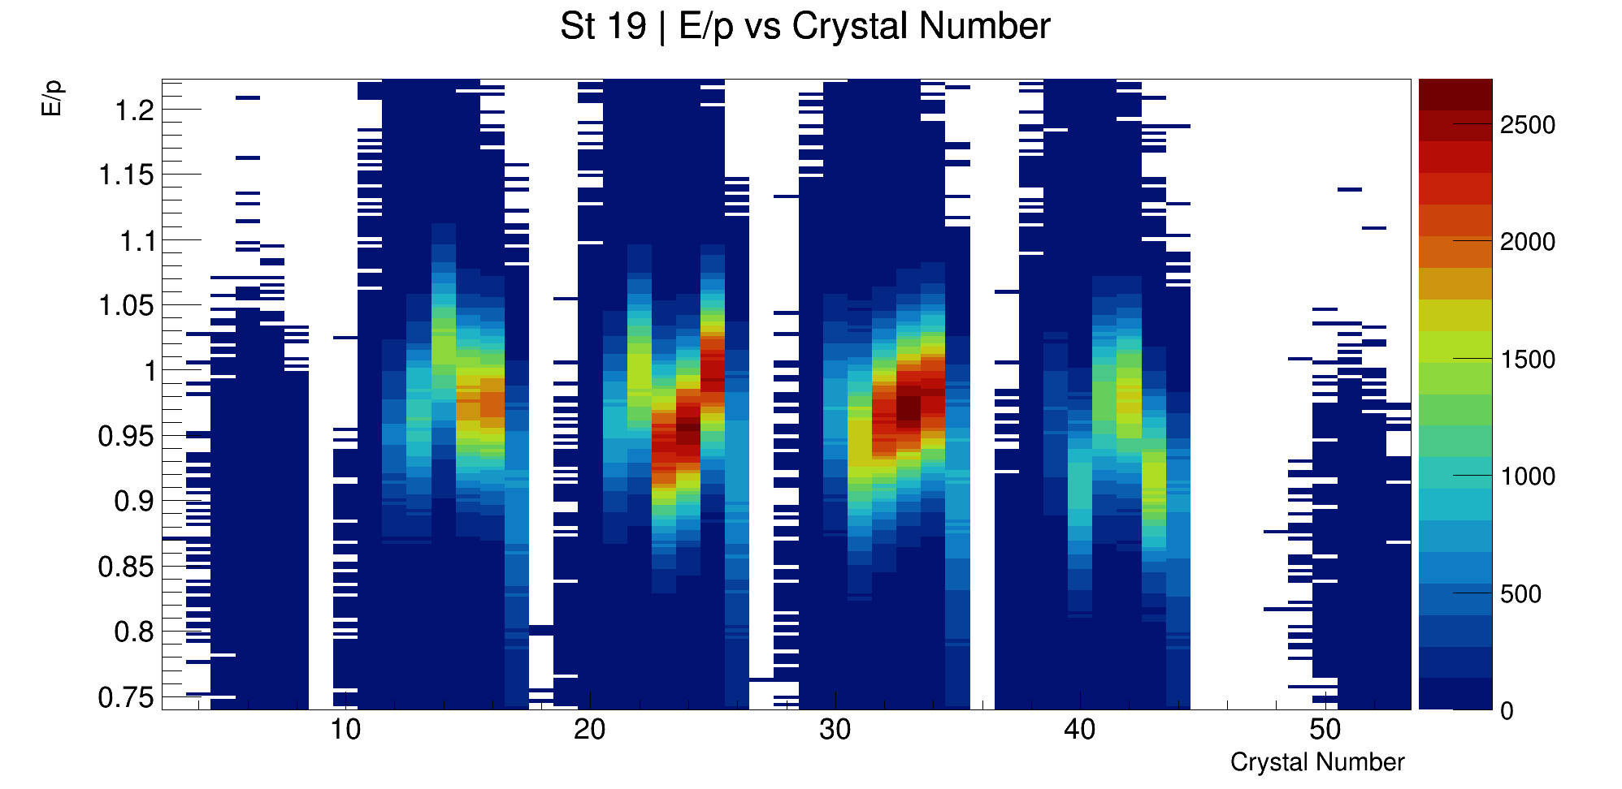
E/p normalisation at time > 60 μs
Different crystals have different mean values of E/p.
Find the gaussian mean E/p per crystal, after 60 μs
Normalise E/p crystal by crystal using these values
Gauss fits in backup

Slide 13
Gauss fits – E/p means per crystal
St 13
St 19
Xtal 0
Xtal 9
Xtal 45

Slide 14
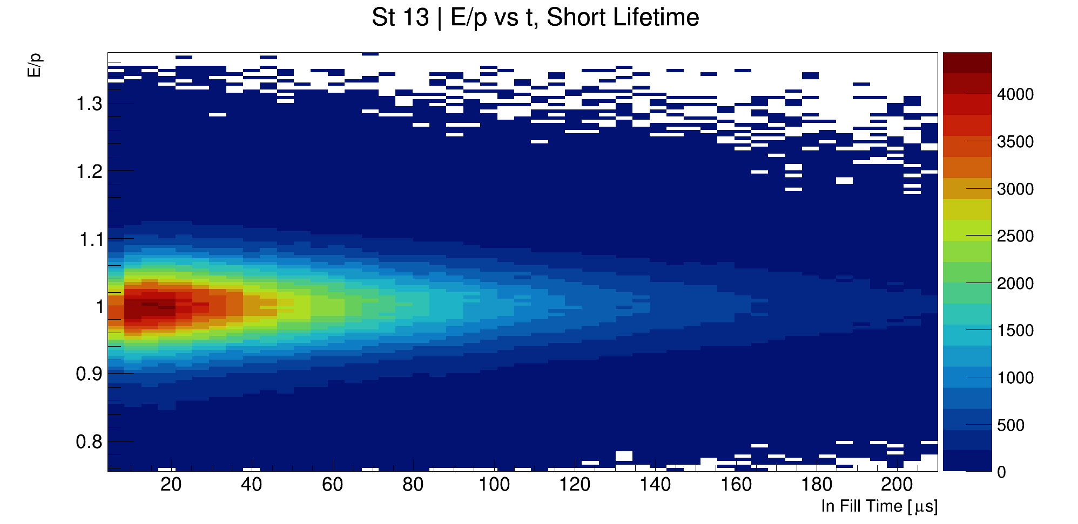
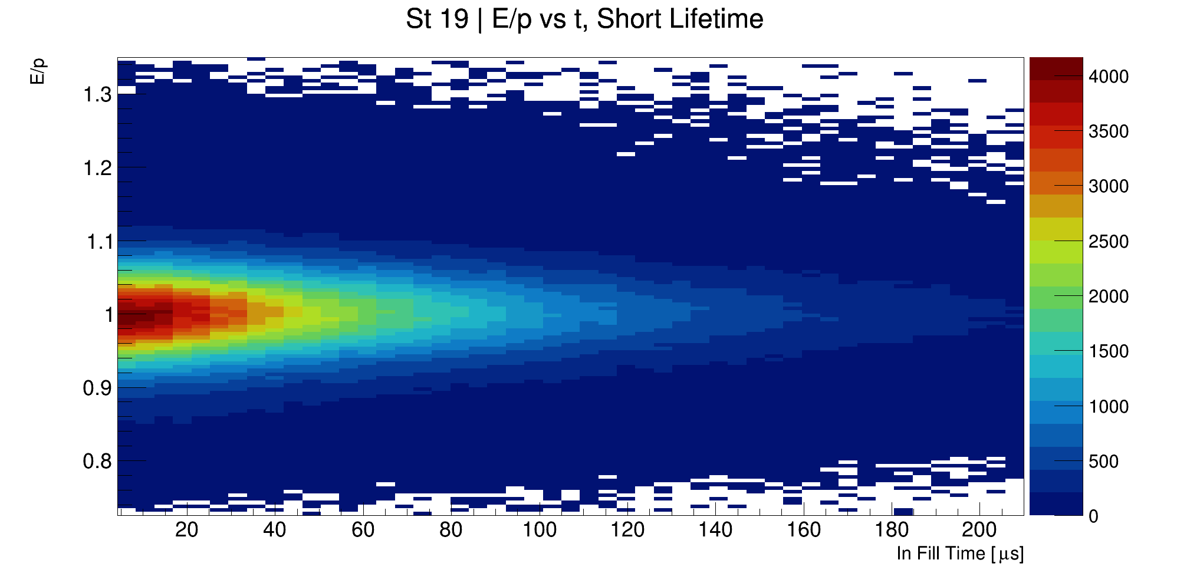
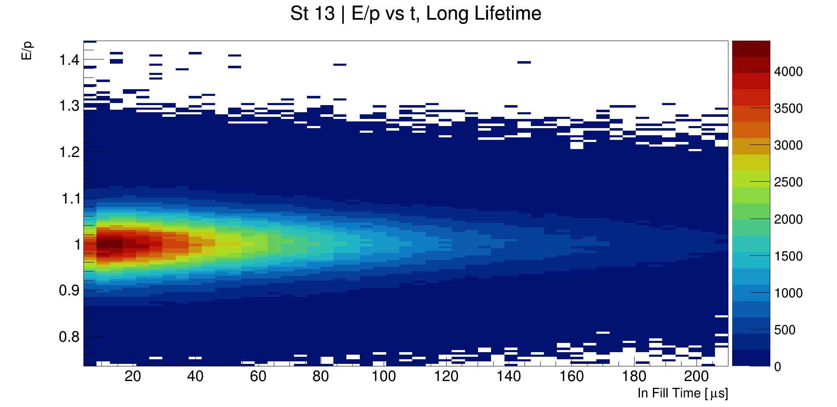
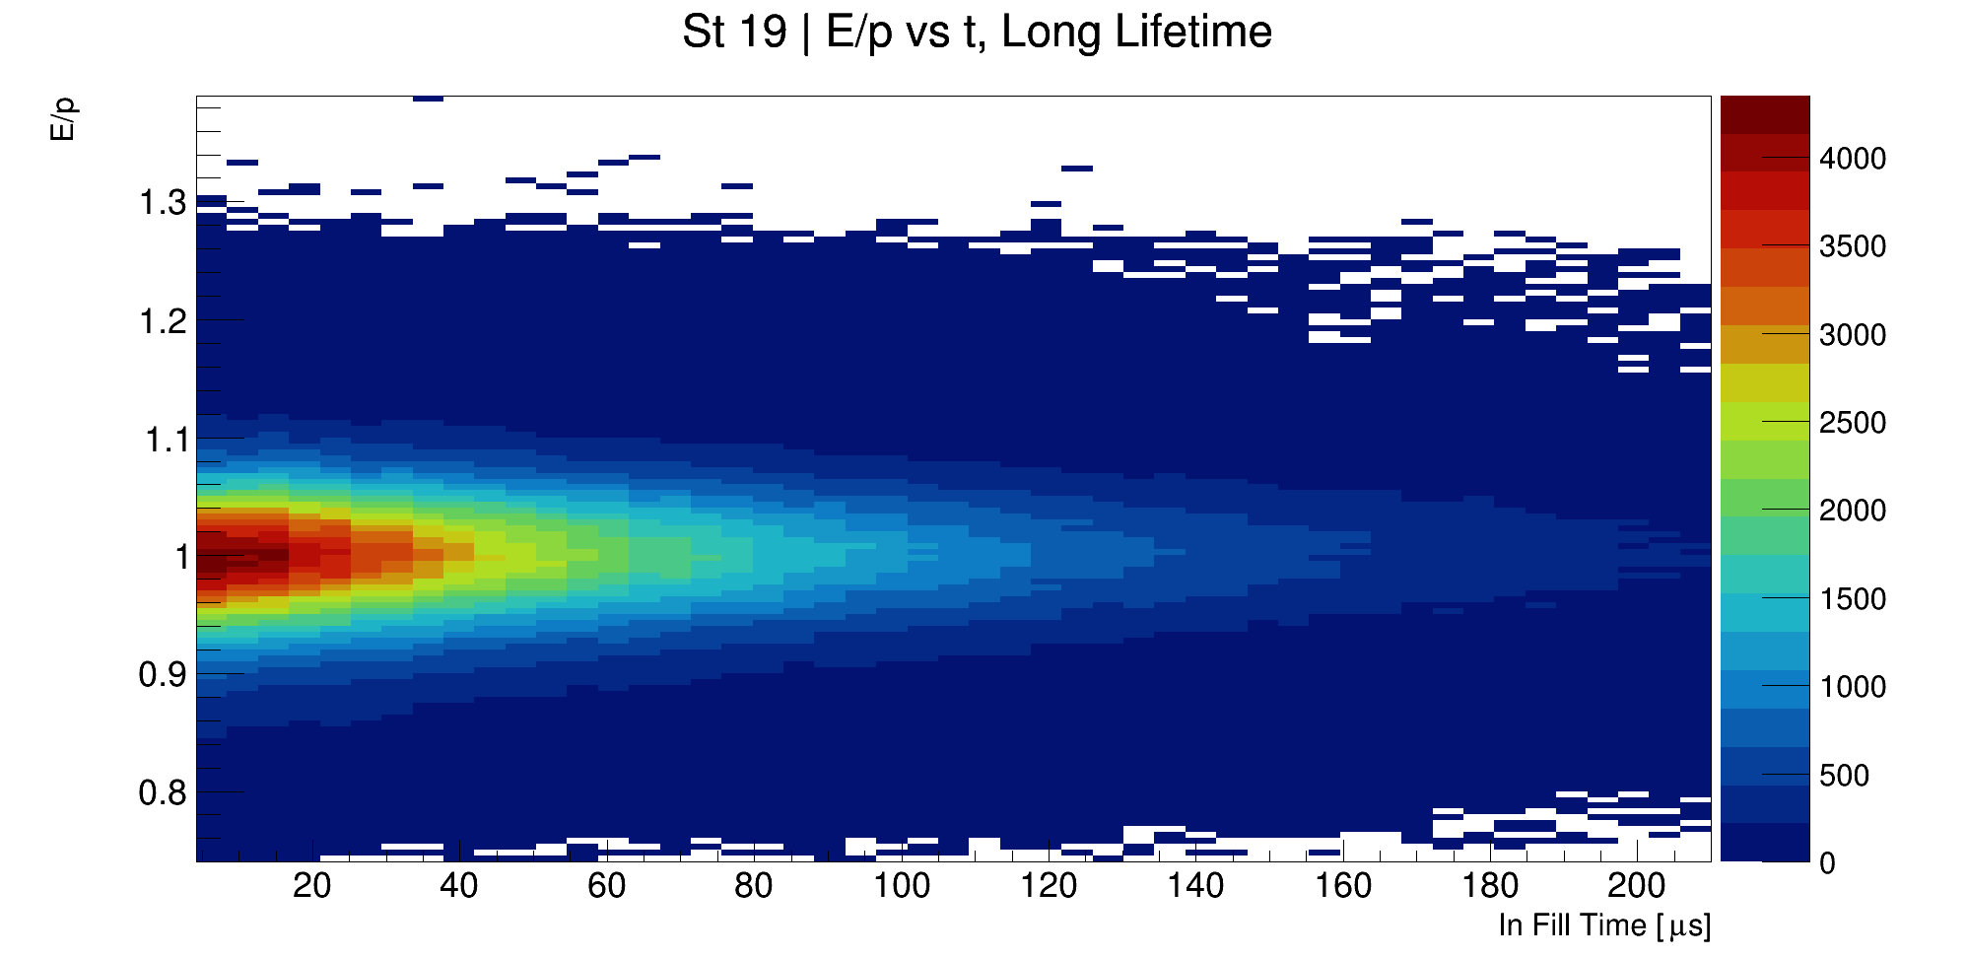
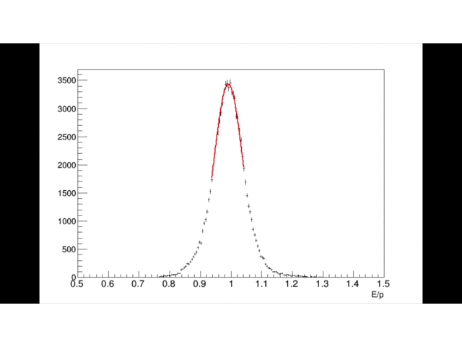
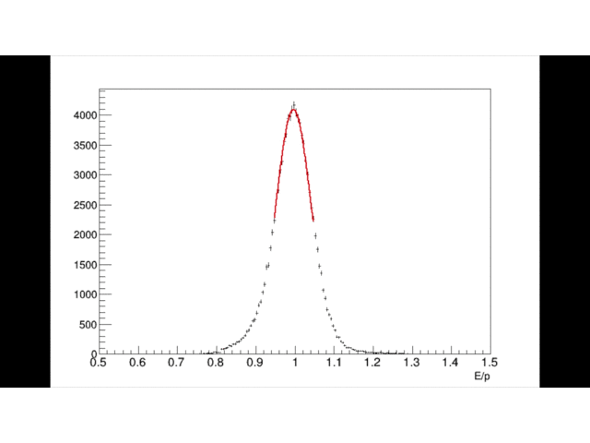
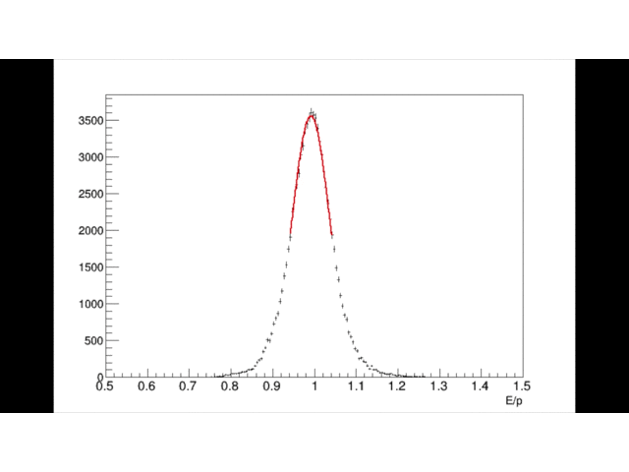
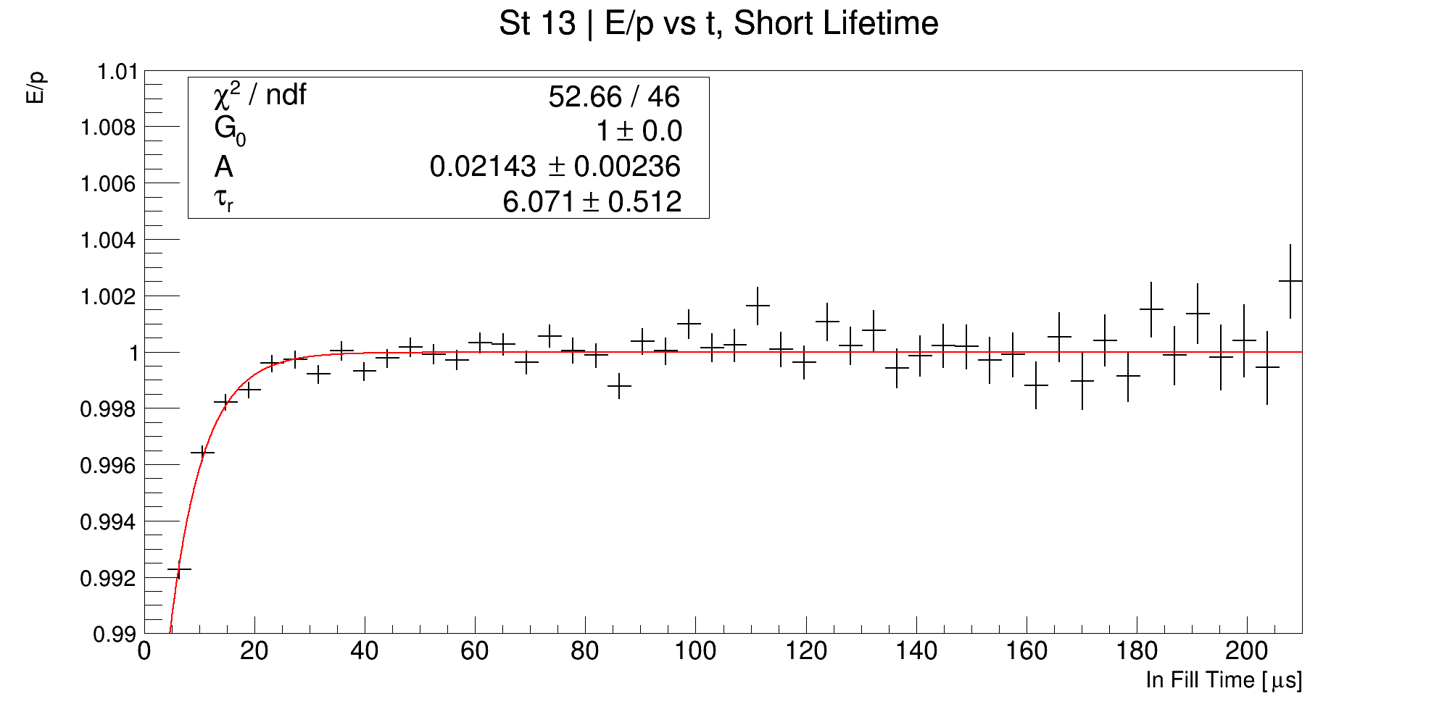
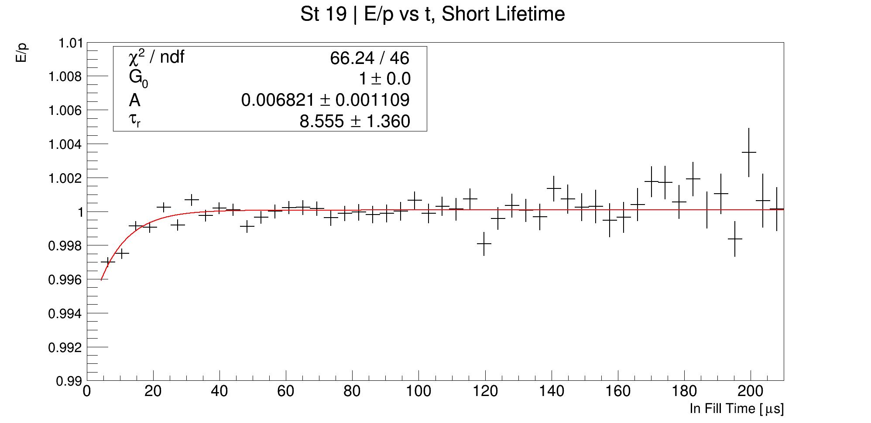
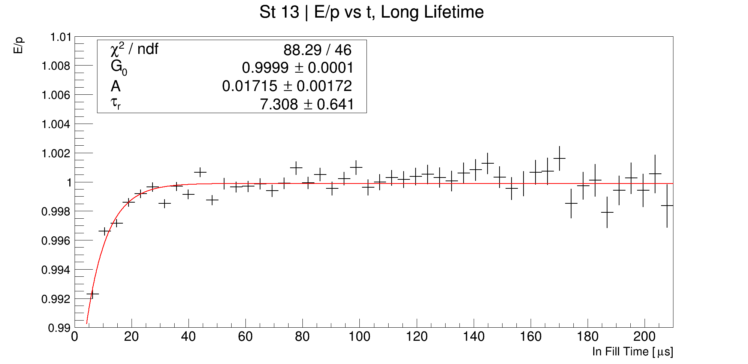
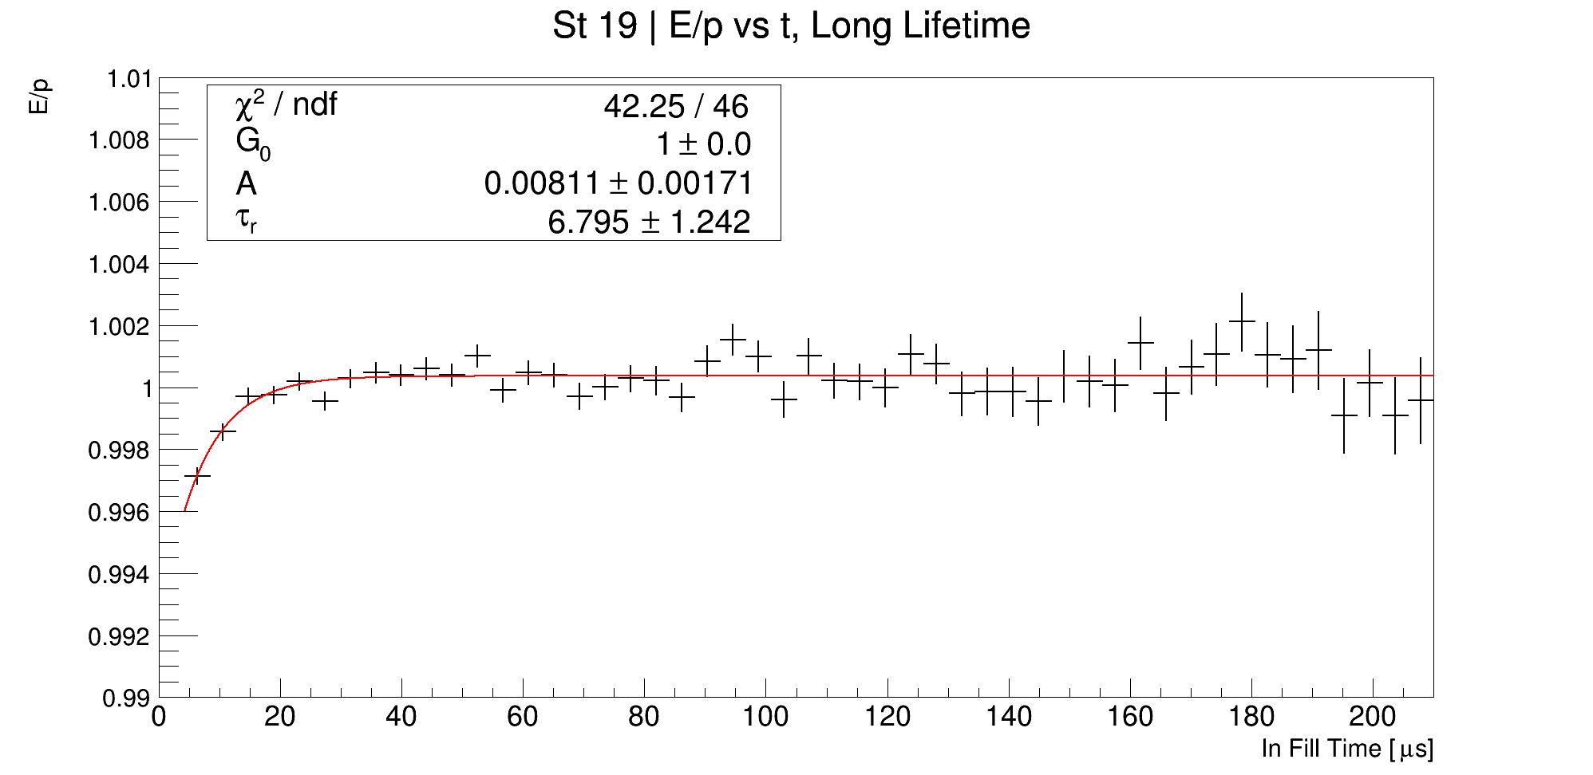
E/p vs time, separated by breaker board

Slide 15
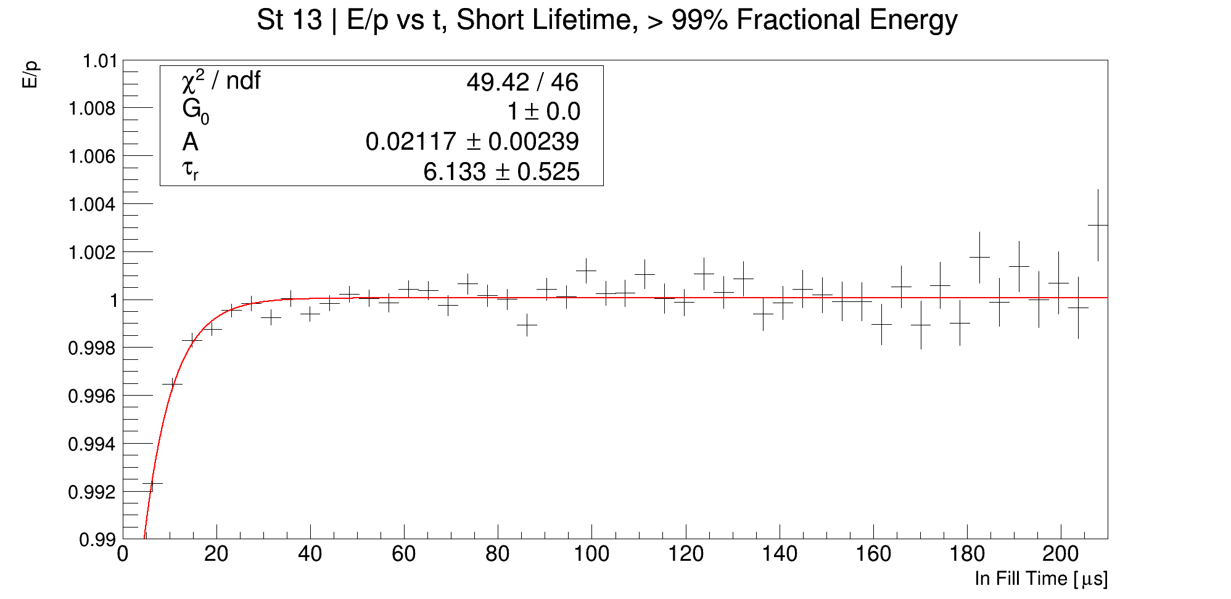
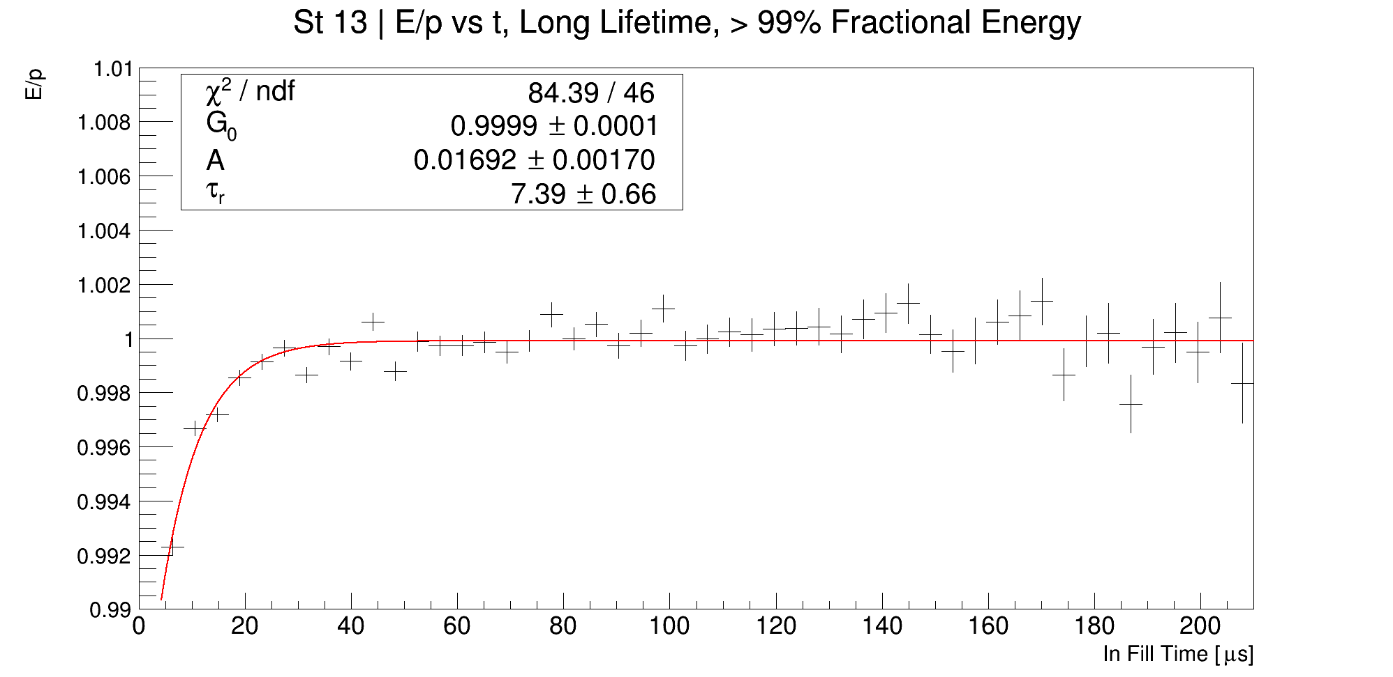
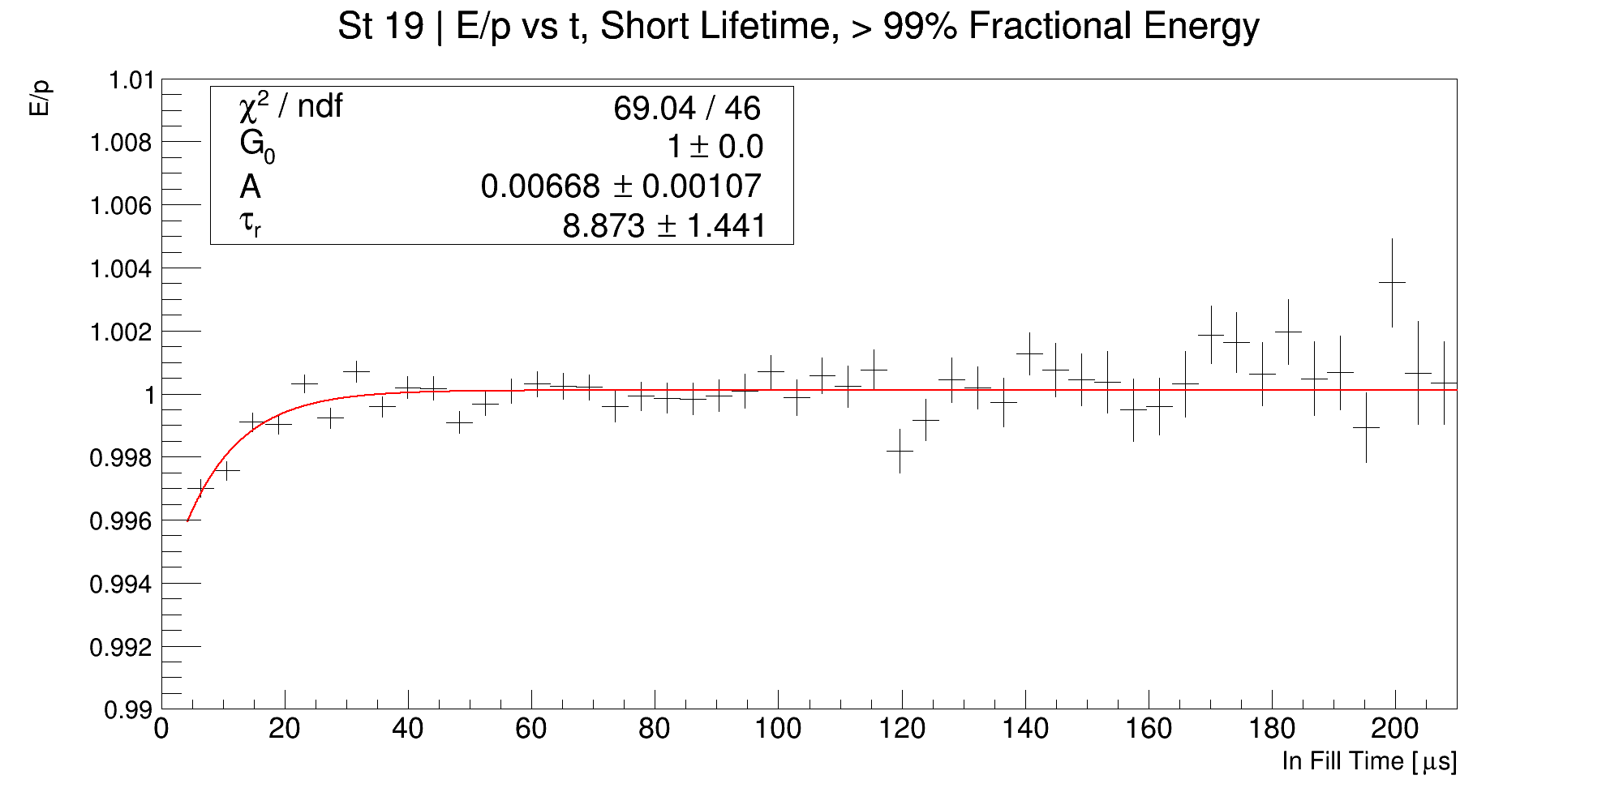
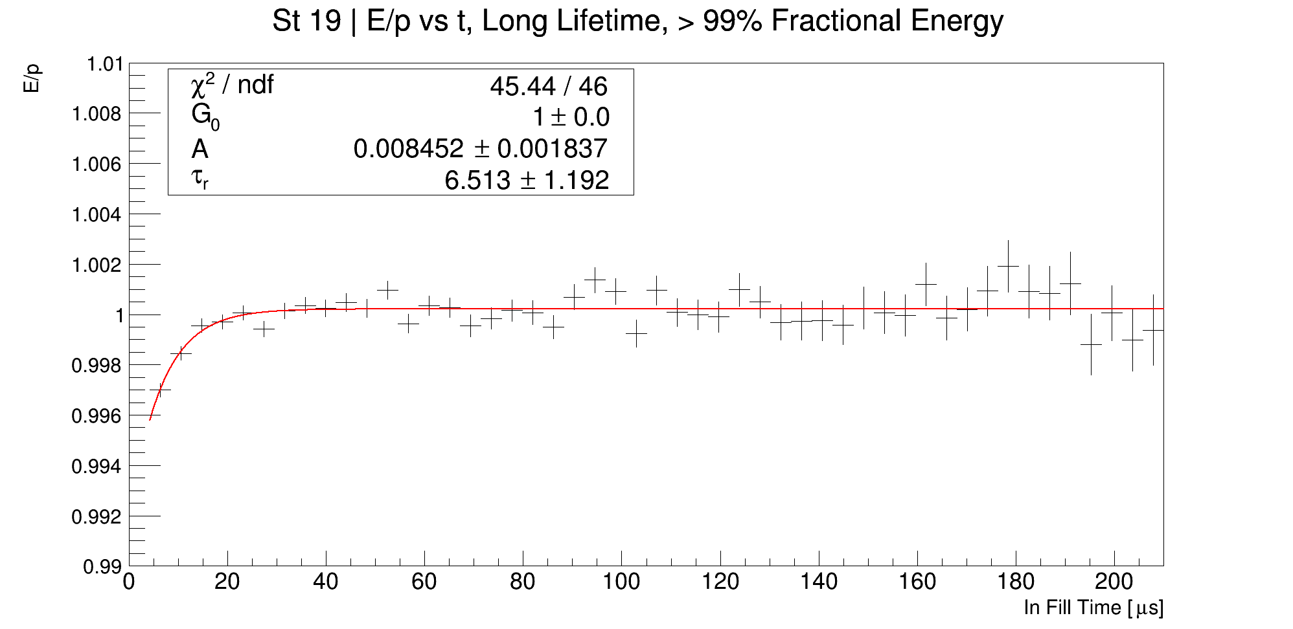
Recovery times per station, > 99% fractional energy

Slide 16
Time difference (dt), radial difference (dR), log(E/p)
Credit: Gavin Hesketh

